Slide 1
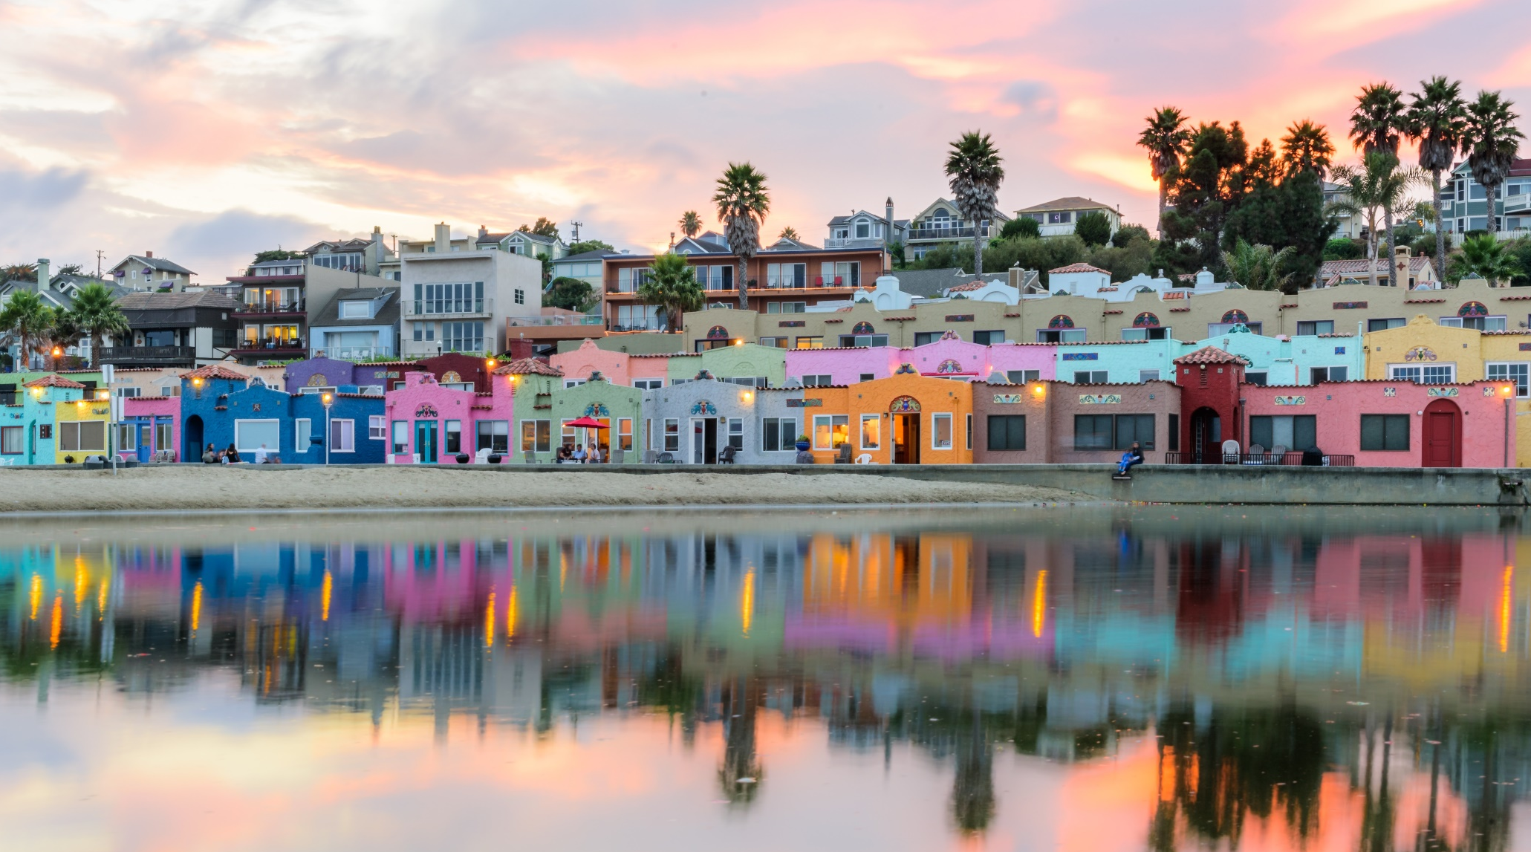

2020 Visit Santa Cruz County LBGTQ+ Hospitality Forum and Training
LGBTQ+ Market Research
Produced by:
January 2020

Slide 2
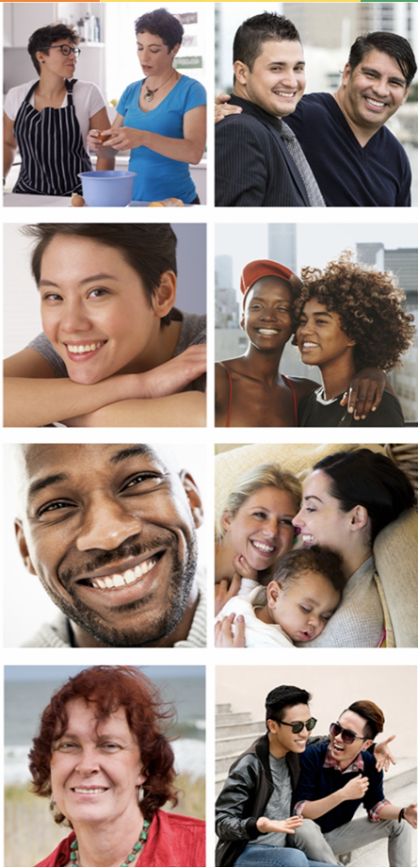
First, a little bit about me and
Community Marketing & Insights (CMI)

Slide 3
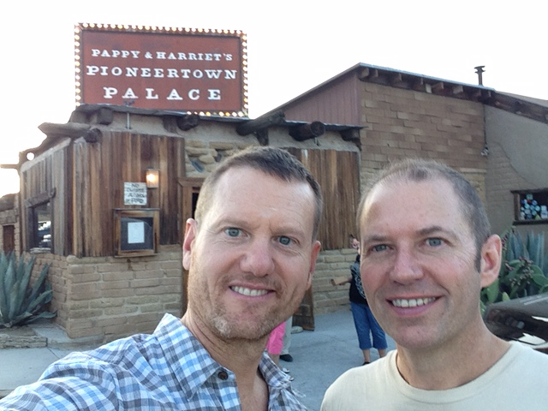
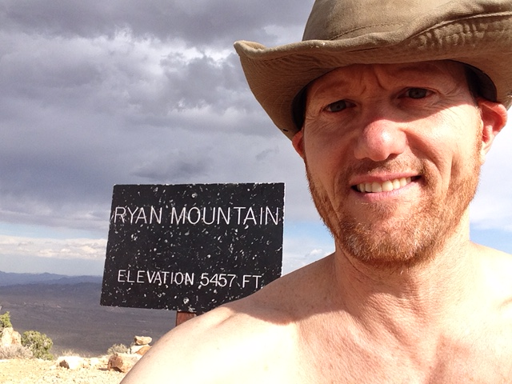
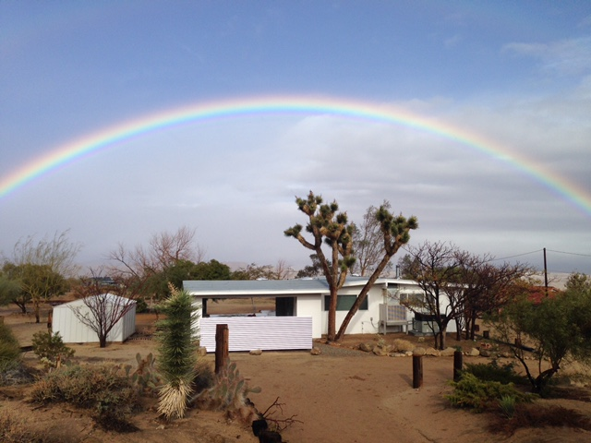
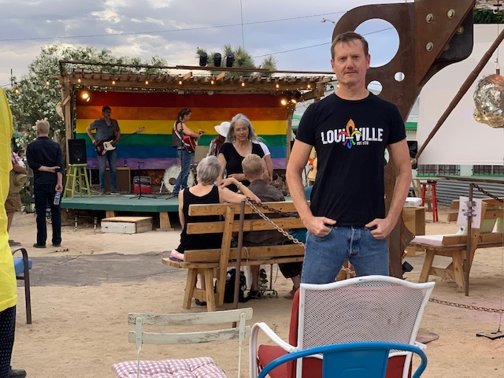
A Little About Me
I have worked for CMI for 25 years
But 5 years ago I hit an urban wall and returned to my more rural background
Now live in Joshua Tree, CA,
population 7,500
I am now a rural gay

Slide 4





























Some of CMI’s LGBTQ Research Clients

Slide 5
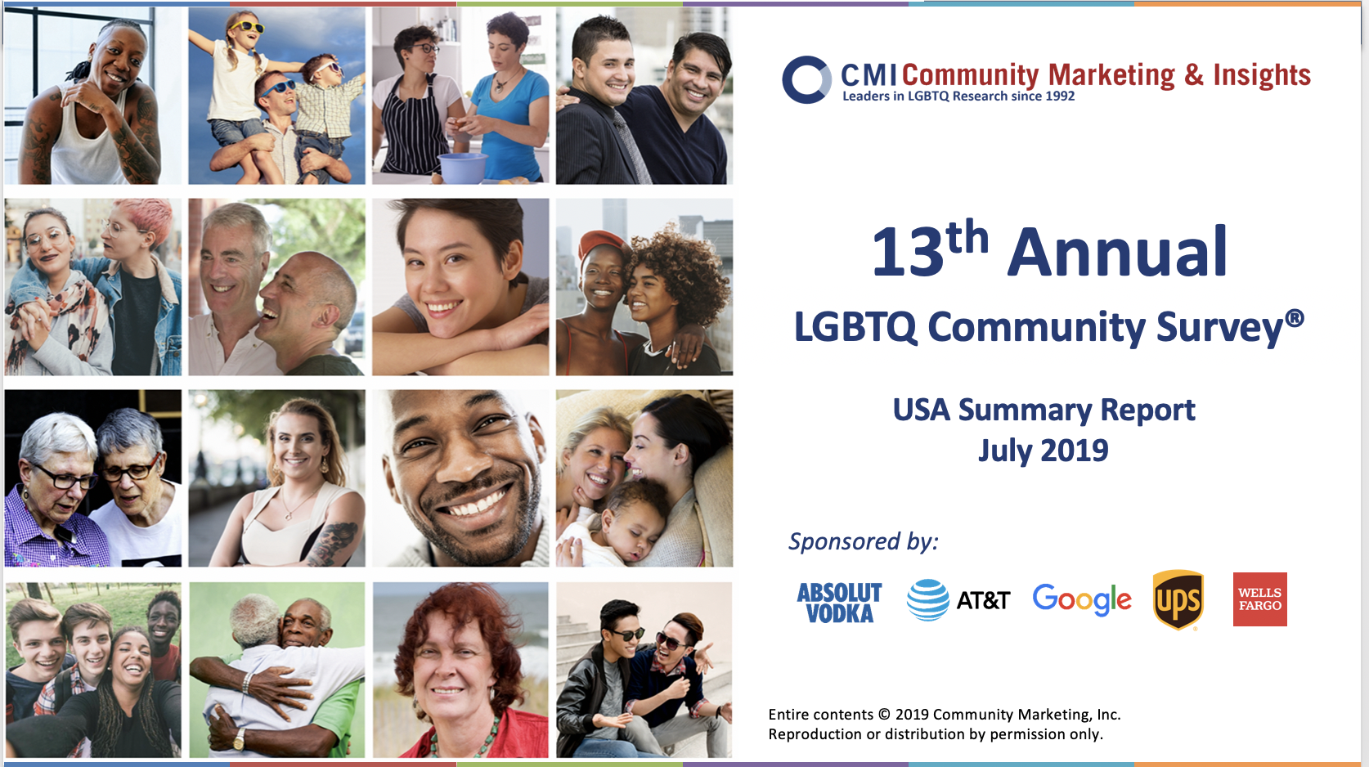
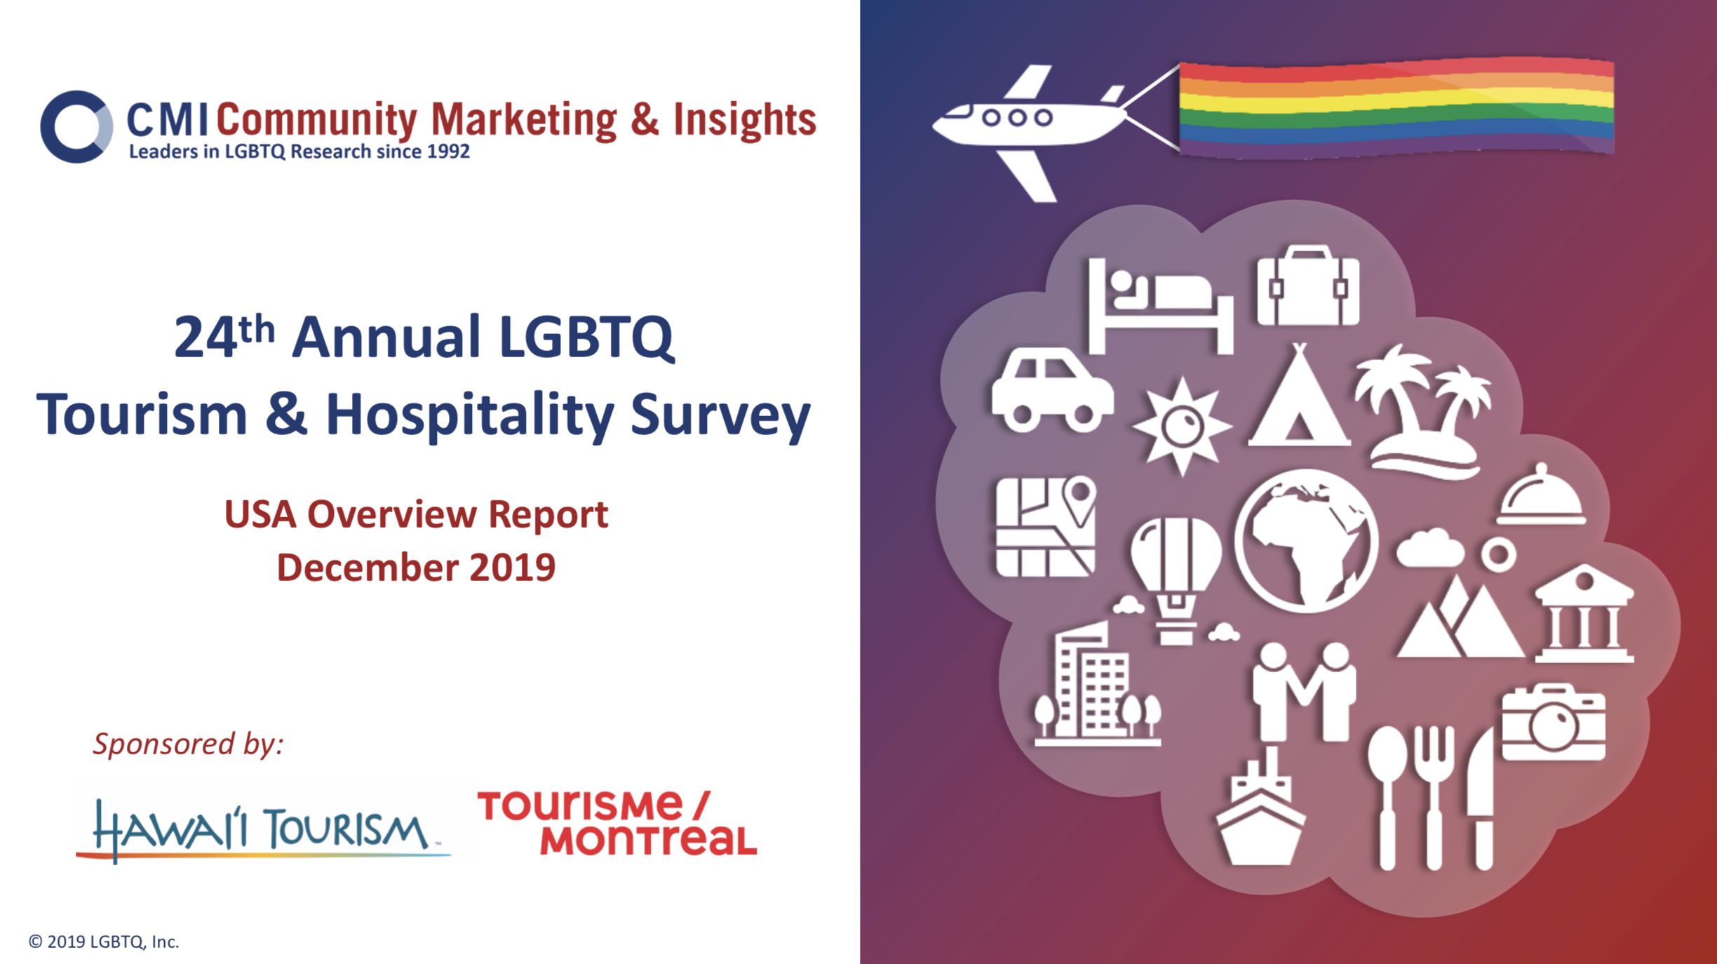
Plenty of Free LGBTQ Research available at
CMI.info

Slide 6
1
Exploring
LGBTQ Demographics

Slide 7
You might ask…
Why does the LGBTQ community receive so much attention in the travel Industry?
Mostly DINK “Dual Income - No Kids”… but that is changing
Perception of greater income / wealth, but that may be a false narrative
Targeted outreach opportunities
Exceptionally brand / destination loyal
Although only 4% to 8% of the adult population, surveys show our travel patterns are greater than the general population.
Travel and geographic migration is part of cultural identity
7

Slide 8
TYPE OF TRAVELER: LGBTQ travelers tend to be more moderate-price travelers, although there are some gender and generational differences.
TYPE OF TRAVELER
Q
In the past year, if you had to pick one, what type of price point traveler are you?
TRAVELER TYPE | All LGBTQ | Gay & Bi Men | Lesbian & Bi Women | Gender Expansive
5 - Luxury traveler | 4% | 5% | 2% | 0%
4 - Moderate price traveler, with a little luxury | 32% | 36% | 28% | 21%
3 - Moderate price travel | 24% | 25% | 25% | 16%
2 - Budget traveler with an occasional splurge | 29% | 24% | 34% | 41%
1 - Budget / economy traveler | 11% | 10% | 11% | 21%
Base: (Weighted) All LGBTQ n=3,633; Gay & Bi Men n=2,242; Lesbian & Bi Women n=1,116;
Gender Expansive n=275; Millennials n=1,183; Gen X n=1,203; Boomers n=1,247

Slide 9
There is No One LGBTQ Market
CMI currently tracks 26 SOGI identities and we add more every year
Gay & Lesbian
Lesbian
Gay woman
Gay man
Bisexual
Biromantic
Pansexual
Panromantic
Bi+
Same-gender loving
Asexual
Queer
Questioning
Straight or heterosexual
Woman
Man
Transgender
Trans Man
Trans Woman
Intersex
Non-binary
Genderqueer
Gender Fluid
Agender
Questioning
Queer
Straight Ally
GLBT
LGBT
LGBTQ
LGBTQ+
LGBTQIA+
LGBTQ2+
???

Slide 10
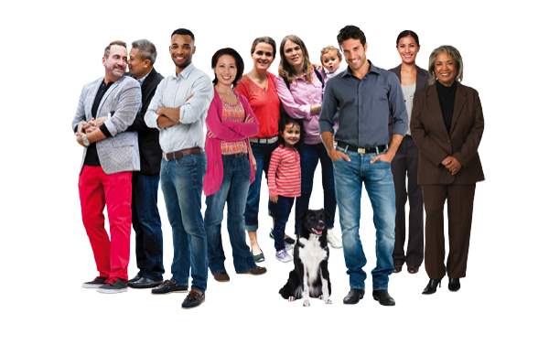
  There is No Singular “LGBTQ” Traveler
  Same-sex gay male couple in SF, no kids, corporate jobs
  Lesbian couple, retired, lives in Oakland
  Single, queer young adult, first job in Silicon Valley
  Bisexual man in an opposite-sex relationship in Marin
  Bisexual woman married to a trans man in Portland
  Gay man in Walnut Creek, just divorced from his husband, looking for something new
  Young, pansexual, genderqueer, ready to change the world
  Add Generation and Ethnicity to the mix and it’s complicated
  These people
  are NOT the
  same consumers.
10

Slide 11
2
Exploring
LGBTQ Travel

Slide 12
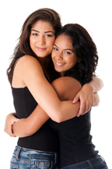
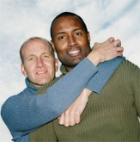
CMI’s 9th Annual LGBT Community Survey:®
If you had to describe yourself or your personality in three words,
which words would you use?
Friendly
Outgoing
Caring
Funny
Intelligent
Loyal
Honest
Fun
Smart
Loving

Slide 13
KEY ATTRIBUTES FOR LGBTQ DESTINATION SELECTION
On a 5-point scale, how important are the following, in your vacation destination selection process?
Among All LGBTQ Travelers
Base: All LGBTQ Travelers n=4,980 – 5,007

Slide 14
VACATION MOTIVATIONS
What motivates you to take vacations?
Please mark any reasons that motivated you to book a trip in the past 12 months.
Top 4 of 14 Responses | All LGBTQ Travelers
To rest and relax | 73%
To get away from my typical everyday life | 69%
To explore someplace new | 69%
To return to a place that I know and enjoy | 53%
Base: All LGBTQ Travelers n=4,882; Millennials+ n=1,540; Gen X n=1,515; Boomers n=1,827

Slide 15



URBAN TRAVEL MOTIVATIONS
When you think of a vacation to an urban destination, what activities attract you the most? Please mark all that apply.
Among All LGBTQ Travelers
Base: All LGBTQ Travelers n=5,355

Slide 16



OUTDOOR TRAVEL MOTIVATIONS • ALL LGBTQ
When you think of outdoor or natural-based vacations, what activities attract you the most? Please mark all that apply.
Among All LGBTQ Travelers
Base: All LGBTQ Travelers n=5,355

Slide 17
OUTDOOR TRAVEL MOTIVATIONS • ALL LGBTQ
When you think of outdoor or natural-based vacations, what activities attract you the most? Please mark all that apply.
Among All LGBTQ Travelers
Base: All LGBTQ Travelers n=5,355

Slide 18
OUTDOOR TRAVEL MOTIVATIONS • BY DEMOGRAPHIC (SELECT RESPONSES)
When you think of outdoor or natural-based vacations, what activities attract you the most?
Please mark all that apply.
 | Gay & Bi+ Men | Lesbian & Bi+ Women | Transgender & Non-binary Participants
Explore beaches and coastal areas | 68% | 73% | 64%
Hike or walk in nature | 60% | 69% | 66%
Visit national/state parks the region is known for | 57% | 70% | 59%
View wildlife or marine life | 44% | 57% | 51%
Experience fall colors | 42% | 54% | 50%
Explore mountains | 40% | 47% | 44%
Experience wildflowers | 22% | 35% | 32%
Explore deserts | 20% | 21% | 22%
Base: Gay & Bi+ Men n=3,341; Lesbian & Bi+ Women n=1,535; Gender Expansive n=479;
Millennials+ n=1,655; Gen X n=1,647; Boomers n=2,053

Slide 19
LGBTQ FAMILY TRAVEL
What types of overnight vacations have you taken with your children in the past 12 months? (Please mark all that apply.)
Urban or city vacation | 55%
Visit family as primary reason for travel | 55%
Beach or beach town | 54%
Resort town, small town or rural destination vacation | 32%
Large theme resort/park (like Disney, Universal, etc.) | 23%
Visit friends as primary reason for travel | 17%
International vacation (outside of your country) | 12%
Other type of vacation | 9%
Base: All LGBTQ that have children under age 18 n=325; All LGBTQ with Children Under
Age 18 and Went on at Least One Trip with Child/Children in the Past 12 Months n=277

Slide 20
3
Santa Cruz County
LGBTQ Tourism Research

Slide 21
RESEARCH DESIGN
Community Marketing & Insights (CMI) has built a proprietary research panel of 90,000+ LGBTQ consumers through partnerships with more than 300 LGBTQ publications, websites, blogs, social media, apps, events, and organizations since 1992.
25 YEARS OF LGBTQ INSIGHTS
An 8-minute online survey conducted in October 2019.
For this research, CMI used a combination of our own panel and outreach through Bay Area LGBTQ media
This report focuses on data for 1,113 self-identified members of the LGBTQ community living in the State of California, including 566 from the Bay Area, 432 from Southern California, and 115 from the rest of California.
Participants included 643 gay and bi+ men, 395 lesbian and bi+ women and 75 transgender and gender non-binary community members.
Weighting: This study utilizes a balanced opinion approach to weighting; (1) Each of the three major adult generations are equally weighted; (2) Gay and bi+ men are weighted at 46.5%, lesbian and bi+ women are weighted at 46.5%, and transgender/non-binary identities are weighted at 7%.
The panel, and results, may not represent LGBTQ community members who are not out or not interacting within the LGBTQ community.

Slide 22
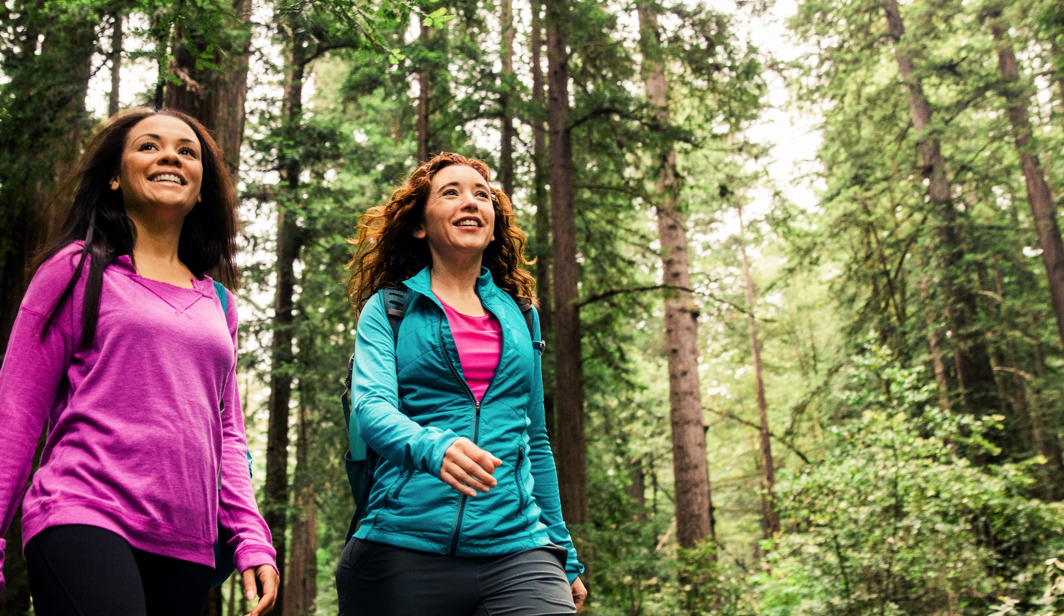
Santa Cruz County and the LGBTQ Traveler | October 2019
TRAVEL BY LGBTQ CALIFORNIANS

Slide 23


How LGBTQ-friendly do you consider these California counties to be, based on what you have experienced or heard? We know that an entire county is a big place with many different destinations, but give your best answer for the entire county.
Among Bay Area Participants
81%
Positive for Santa Cruz County
Base: All Bay Area Participants n=562-565

Slide 24
How LGBTQ-friendly do you consider these California counties to be, based on what you have experienced or heard? We know that an entire county is a big place with many different destinations, but give your best answer for the entire county
.
Santa Cruz Among Bay Area Participants
All Transgender and Non-binary participants 40% very and 36% somewhat LGBTQ friendly
Base: All Bay Area Participants n=565

Slide 25
In the past year, have you traveled to any of these California counties for vacation or a weekend getaway?
Please indicate if you stayed overnight or it was a day trip.
Among Bay Area Participants
Base: All Bay Area Participants n=566

Slide 26
In the past year, have you traveled to any of these California counties for vacation or a weekend getaway?
Please indicate if you stayed overnight or it was a day trip.
Visited Santa Cruz Among Bay Area Participants

Slide 27
How interested are you in traveling to any of these counties in the next year for an overnight or day trip?
Among Bay Area Participants
Base: All Bay Area Participants n=566

Slide 28
How interested are you in traveling to any of these counties in the next year for an overnight or day trip?
Santa Cruz Among Bay Area Participants

Slide 29

Among Southern California Participants
LGBTQ-friendly
Past Year Travel
Interest in Next Year Travel
The research indicates that Southern California could be a viable secondary market if budget allows,
but visitation from Southern Californians is about a quarter than that of Bay Area LGBTQ community members. Interest in visiting Santa Cruz is about half that of Bay Area residents.
Base: All Southern California Participants n=428-432

Slide 30
New Question Only About Santa Cruz: Bay Area Residents Last Overnight Visit to Santa Cruz
When is the last time you visited Santa Cruz County, and spent a night in a hotel, paid accommodation or overnight with a friend or family?
Among Bay Area Participants
 | Gay & Bi+ Men | Lesbian & Bi+ Women | Millennial+ | Gen X | Boomers+
In the past year | 18% | 22% | 25% | 18% | 14%
1 to less than 2 years ago | 10% | 12% | 12% | 11% | 13%
Two year visitation rate | 28% | 34% | 37% | 29% | 23%
Base: Bay Area n=556

Slide 31
Where in Santa Cruz County did you go on any trip in the past two years? Please mark all that apply.
Among Bay Area Past 2-Year Visitors
 | Gay & Bi+ Men | Lesbian & Bi+ Women
City of Santa Cruz | 93% | 88%
City of Capitola | 29% | 37%
Aptos | 18% | 19%
City of Scotts Valley | 15% | 12%
City of Watsonville | 12% | 18%
San Lorenzo Valley | 11% | 13%
Davenport (north coast) | 4% | 18%
Other areas of Santa Cruz County | 11% | 25%
Base: All Bay Area 2-Year Visitors n=304

Slide 32
Think of your trips to Santa Cruz in the past two years. What months did you visit?
If applicable, it is OK to check more than one for multiple trips.
Among Those in the Bay Area Took At Least One Overnight
or Daytrip to Santa Cruz in the Past Year
Base: Bay Area Took At Least One Overnight Trip to Santa Cruz n=135;
Bay Area Took At Least One Day Trip to Santa Cruz n=224

Slide 33

Santa Cruz Past 2-Year Overnight Visitors: This graph considers unweighted data to look for overrepresentation for different counties.
 | All LGBTQ Participants | 2-year Overnight Visitors
San Francisco County | 24% | 27%
Alameda, Contra Costa or Solano County | 16% | 22%
San Mateo County | 4% | 8%
Santa Clara County | 4% | 6%
Sacramento or Yolo County | 6% | 7%
Los Angeles or Orange County | 23% | 10%
San Diego County | 8% | 4%
Unweighted
Base: All LGBTQ n=1,113; Those Visited Santa Cruz in the Past 2 Years and Stayed Overnight n=246

Slide 34
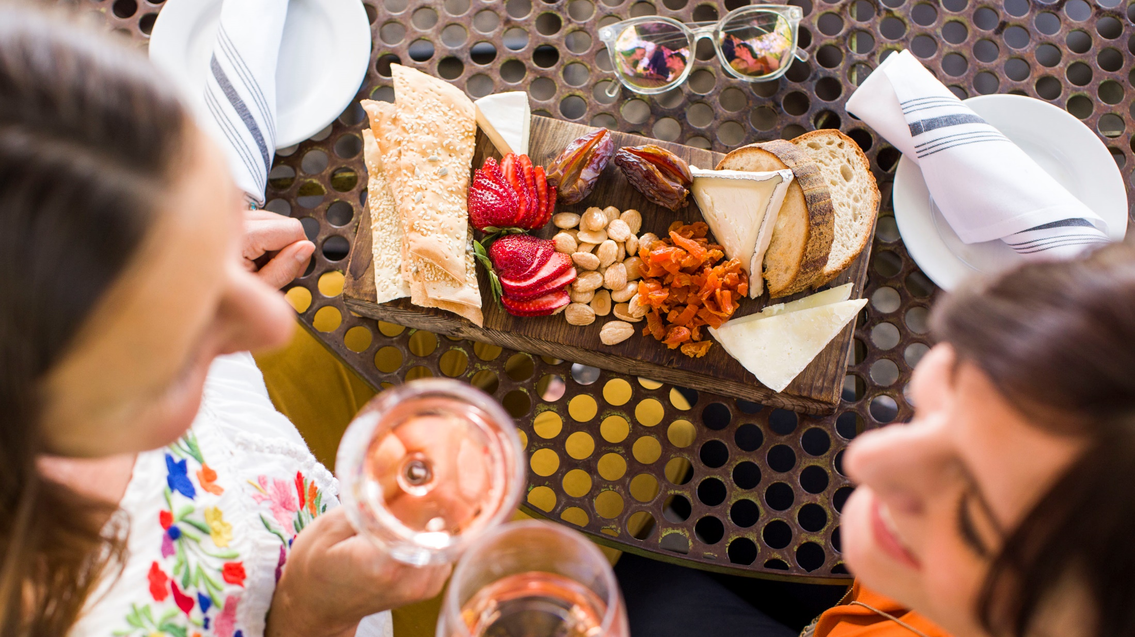
Santa Cruz County and the LGBTQ Traveler | October 2019
TRAVEL MOTIVATIONS FOR
LGBTQ BAY AREA RESIDENTS

Slide 35
Think about a weekend getaway trip to California destinations along the coast or wine country. When thinking about a vacation trip to these types of destinations, which of the following attributes are most appealing or might encourage a trip. Please mark all that apply.
Among Bay Area Participants
Base: All Bay Area Participants n=566

Slide 36
Base: All Bay Area Participants n=566

Slide 37
Base: All Bay Area Participants n=566

Slide 38
Base: All Bay Area Participants n=566

Slide 39
Motivations: Demographic Breakdown for Bay Area Residents (Select Responses)
Think about a weekend getaway trip to California destinations along the coast or wine country. When thinking about a vacation trip to these types of destinations, which of the following attributes are most appealing or might encourage a trip? Please mark all that apply.
Among Bay Area Participants
 | Millennial+ | Gen X | Boomers+
Restaurants featuring locally sourced foods | 66% | 72% | 70%
Arts and cultural activities | 66% | 70% | 66%
Beaches | 71% | 67% | 61%
Hiking in the redwoods | 69% | 67% | 55%
Hiking along the coast | 66% | 65% | 53%
Winery tours / wine tasting | 57% | 57% | 48%
LGBTQ events happening outside of big cities | 50% | 58% | 45%
Historical or heritage tourism | 38% | 53% | 53%
Whale watching / wildlife watching | 39% | 46% | 53%
Brewery tours / beer tasting | 40% | 31% | 20%
Base: All Bay Area Participants Gay & Bi+ Men n=332; Lesbian &
Bi+ Women n=199; Millennial+ n=96; Gen X n=166; Boomers+ n=304

Slide 40
When thinking about a trip to a destination in smaller cities, towns and rural areas in California, what types of hotels or paid accommodations are you most likely to book? Please mark all that apply.
Among Bay Area Participants
Base: All Bay Area Participants n=566

Slide 41
Accommodations: Demographic Breakdown for Bay Area Residents (Select Responses)
When thinking about a trip to a destination in smaller cities, towns and rural areas in California, what types of hotels or paid accommodations are you most likely to book? Please mark all that apply.
Among Bay Area Participants
 | Gay & Bi+ Men | Lesbian & Bi+ Women | Transgender/ Non-Binary* | Millennial+ | Gen X | Boomers+
Airbnb or similar vacation rental service / properties | 55% | 63% | 44% | 75% | 57% | 42%
Bed and Breakfasts | 46% | 54% | 46% | 54% | 51% | 43%
Trendy small boutique hotels | 53% | 39% | 29% | 50% | 49% | 35%
Historic small hotels | 42% | 46% | 40% | 32% | 51% | 46%
Medium sized hotels | 45% | 36% | 37% | 36% | 46% | 39%
Budget motels | 29% | 32% | 53% | 32% | 30% | 33%
Large resort hotels | 26% | 15% | 12% | 20% | 24% | 15%
Base: All Bay Area Participants Gay & Bi+ Men n=332; Lesbian &
Bi+ Women n=199; Millennial+ n=96; Gen X n=166; Boomers+ n=304
Transgender/Non-binary for all CA dur to low base n=78

Slide 42
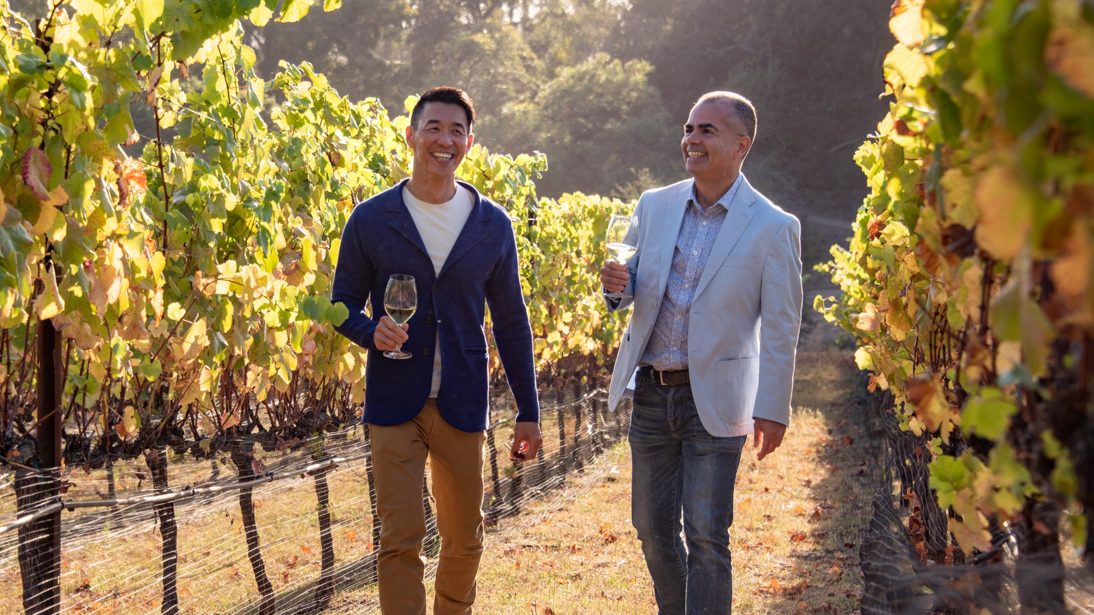
Santa Cruz County and the LGBTQ Traveler | October 2019
Motivations to Visit Santa Cruz County

Slide 43
Bay Area Positive Initial Thoughts of Santa Cruz County
The rest of this short survey will be about travel to the city of Santa Cruz and Santa Cruz County. Before we ask specific questions, what are your impressions of the Santa Cruz area as a tourism destination? Please list up to two positive impressions and two negative impressions you have about Santa Cruz, based on all that you know or have seen or heard from friends, family or the media.
Positive Impressions | % of those participating In exercise |  | % of those participating In exercise
Beach | 41% | LGBTQ-friendly (or variance) | 5%
Beautiful / Scenic / Pretty | 23% | Nature / Natural | 4%
Boardwalk | 21% | Redwoods / Forests | 4%
Casual / Relaxing / Laid back | 18% | Hippie / Quirky | 3%
Fun | 14% | Easy to get to | 3%
Good weather / Sunny / Warm / Mild / Climate | 12% | Downtown / Pacific Ave | 3%
Frieindly people | 11% | Arts | 3%
Restaurants / Food / Cuisine / Seafood | 8% | Family | 2%
Coast | 7% | Mountains | 2%
Liberal / Progressive | 5% | Hiking / Hike | 2%
College / University | 5% | Wine | 2%
Base: 511 Bay Area LGBTQ residents participated in the exercise

Slide 44
Bay Area Negative Initial Thoughts of Santa Cruz County
The rest of this short survey will be about travel to the city of Santa Cruz and Santa Cruz County. Before we ask specific questions, what are your impressions of the Santa Cruz area as a tourism destination? Please list up to two positive impressions and two negative impressions you have about Santa Cruz, based on all that you know or have seen or heard from friends, family or the media.
Negative Impressions | % of those participating In exercise
Traffic (especially getting there) / Too far to get there | 21%
Crowded (especially Boardwalk Area) | 17%
Homeless / Panhandlers | 14%
Expensive / costs / pricey | 11%
Touristy | 10%
Dirty / Grungy / Run down / Messy | 9%
Parking | 7%
Lack of LGBTQ spaces / Too straight | 7%
Too many drugs / Potheads | 6%
You said that you have not visited Santa Cruz County in the past two years. Why not? Please mark all that apply.
Among Santa Cruz Past 2-Year Non-Visitors
 | Bay Area
Other destinations interest me more | 45%
Hard to get to | 25%
Never thought of Santa Cruz County as a vacation destination | 22%
I do not have a car | 21%
I do not know anyone there | 21%
I do not know what to do there | 20%
Base: 480 Bay Area LGBTQ residents participated in the exercise

Slide 45
What were your primary motivators to visit Santa Cruz County in the past two years?
Please mark all that apply.
Among Bay Area Past 2-Year Visitors
 | Bay Area |  | Bay Area
Visit Santa Cruz Beach Boardwalk | 50% | Visit University of California Santa Cruz | 13%
Hang out at the beach | 47% | Visit historical sites or heritage tourism | 7%
Relax, rejuvenate or chill | 43% | Visit Roaring Camp Railroads | 6%
Connect and have fun with my partner/spouse | 36% | Whale watching / wildlife watching | 6%
Connect and have fun with my friends | 32% | Attend Santa Cruz Pride or other LGBTQ event | 6%
Experience local restaurants | 29% | Family activities with my children | 6%
Hike in the Redwoods | 18% | Brewery tours / beer tasting | 6%
Hike along the Coast | 17% | Winery tours / wine tasting | 6%
Unique local shopping | 17% | Bike (road bike or mountain bike) | 4%
Arts and cultural activities | 16% | Farm tour or U-pick experiences | 3%
Shop or dine along Pacific Ave | 15% | Attend a sporting event | 2%
Attend an event or concert | 13% | Other | 16%
Base: All Bay Area 2-Year Visitors n=304

Slide 46
Now let’s think about a vacation to Santa Cruz County. Which of these attributes or activities might encourage you to take a trip to Santa Cruz in the future? Please mark all that apply.
Among Bay Area Participants
 | Bay Area |  | Bay Area
Hang out at the beach | 57% | Shop or dine along Pacific Ave | 29%
Relax, rejuvenate or chill | 56% | Winery tours / wine tasting | 28%
Visit Santa Cruz Beach Boardwalk | 51% | Visit historical sites or heritage tourism | 28%
Experience local restaurants | 50% | Brewery tours / beer tasting | 21%
Hike in the Redwoods | 48% | Farm tour or U-pick experiences | 17%
Hike along the Coast | 47% | Visit Roaring Camp Railroads | 14%
Arts and cultural activities | 44% | Visit University of California Santa Cruz | 13%
Connect and have fun with my partner / spouse | 43% | Bike (road bike or mountain bike) | 12%
Connect and have fun with my friends | 38% | Family activities with my children | 5%
Attend an event or concert | 37% | Attend a sporting event | 3%
Attend Santa Cruz Pride or other LGBTQ event | 36% | Other | 3%
Whale watching / wildlife watching | 33% | I do not have interest in visiting Santa Cruz County | 4%
Unique local shopping | 30%
Base: Bay Area Participants n=556

Slide 47
PAST: 2-Year Visitors
FUTURE: All Participants
 | Bay Area
Visit Santa Cruz Beach Boardwalk | 50%
Hang out at the beach | 47%
Relax, rejuvenate or chill | 43%
Connect and have fun with my partner/spouse | 36%
Connect and have fun with my friends | 32%
Experience local restaurants | 29%
Hike in the Redwoods | 18%
Hike along the Coast | 17%
Unique local shopping | 17%
Arts and cultural activities | 16%
Shop or dine along Pacific Ave | 15%
Attend an event or concert | 13%
 | Bay Area
Hang out at the beach | 57%
Relax, rejuvenate or chill | 56%
Visit Santa Cruz Beach Boardwalk | 51%
Experience local restaurants | 50%
Hike in the Redwoods | 48%
Hike along the Coast | 47%
Arts and cultural activities | 44%
Connect and have fun with my partner / spouse | 43%
Connect and have fun with my friends | 38%
Attend an event or concert | 37%
Attend Santa Cruz Pride or other LGBTQ event | 36%
Whale watching / wildlife watching | 33%
Unique local shopping | 30%
Base: Bay Area Participants n=556

Slide 48
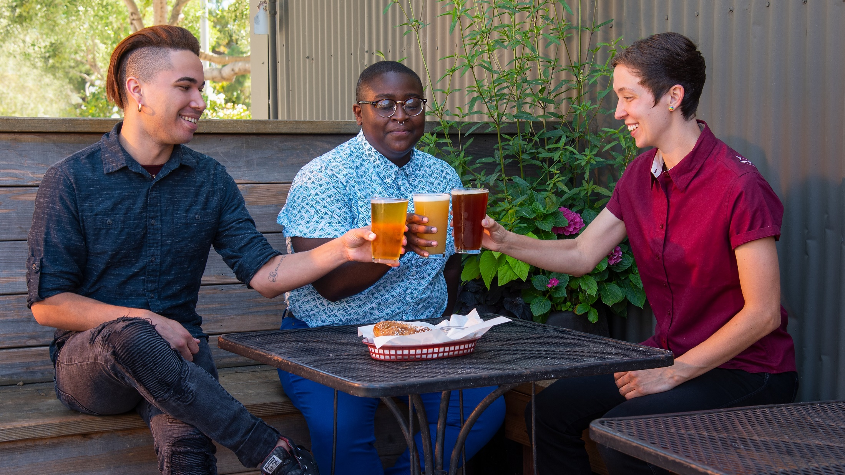
Santa Cruz County and the LGBTQ Traveler | October 2019
Additional Thoughts from the Research

Slide 49
4
Increasing
LGBTQ Tourism

Slide 50
In the past few months, have you seen advertisements, articles, social media posts or blogs encouraging you to visit any of these destinations? Mark those that you remember seeing advertising on any type of media.
Base: All LGBTQ n=1,113; Bay Area n=556

Slide 51
Where do you remember seeing advertisements, social media posts, articles or blogs for travel to Santa Cruz? Please mark all that apply.
Among Those Indicated Seeing Advertisement About Santa Cruz
 | Bay Area Residents
Television | 47%
Newspapers or magazines for general population | 37%
Ads, posts or stories on social media | 34%
Websites for general population | 24%
LGBTQ-specific newspapers or magazines | 17%
Radio | 17%
Outdoor road/highway advertising like billboards | 16%
Urban outdoor advertising like posters in subways or on bus shelters | 13%
LGBTQ-specific websites | 8%
None of the above | 3%
Base: Those Indicated Seeing Advertisement About Santa Cruz Bay Area n=151

Slide 52


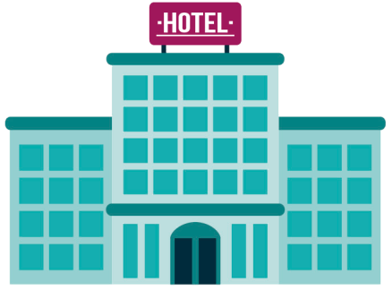



HOTEL SELECTION
When you shop for hotels, how would you rank the following motivators in your selection process?
(Please drag and rank.)
Average
Ranking
Location of hotel in destination | 2.0
Value of price for hotel quality | 2.1
Low Price | 3.4
LGBTQ-friendly reputation | 3.4
Hotel customer loyalty program | 4.0
Base: Varies

Slide 53


The travel industry is a somewhat LGBTQ saturated / mature market.
How will you stand out?
I tend to stay at hotel brands that I know are LGBTQ-welcoming.
Agree Total
(Strongly + Somewhat)
Disagree Total
(Strongly + Somewhat)
Today, all the major hotel brands are LGBTQ-welcoming.
Agree Total
(Strongly + Somewhat)
Disagree Total
(Strongly + Somewhat)
Question: Do you agree or disagree with these statements about hotels?
Base: Weighted All LGBTQ Travelers n=4,666

Slide 54
Which type(s) of LGBTQ events have you attended in the past 12 months?
Please mark all that apply.
Among All LGBTQ
Among All LGBTQ
Among Gender-Expansive
Among Lesbian/Bi Women
Among Lesbian/Bi Women
Among Gay/Bi Men
Among Gay/Bi Men
Among Bisexual/Pansexual Participants
Among AA/Black
Among Asian/Pacific Islander
Among Latino/Latina/Latinx
Base: All LGBTQ n=11,639

Slide 55
Outreach: Specific to Destination, Budget and Goals
MARKETS
OPPORTUNITIES
COMMUNICATIONS
Print
Internet
Social media
Mobile
Influencers
Media relations
Direct contact
TV and Radio
Community involvement
L, G, B or T
Older
Younger
Ethnic
West Coast
East Coast
Single
Couples
Families
Lesiure Travel
Business Travel
Meetings
Conferences
LGBTQ Events
General Events
55

Slide 56
Identify your LGBTQ tourism assets.
What are your top 10 non-LGBTQ tourism assets that are a good fit for the LGBTQ community?
1.
2.
3.
4.
5.
6.
7.
8.
9.
10.
What are your top 10
LGBTQ-specific tourism assets?
1.
2.
3.
4.
5.
6.
7.
8.
9.
10.

Slide 57
Identify your LGBTQ tourism barriers.
Are there potential barriers for LGBTQ travel?
1.
2.
3.
4.
5.
6.
7.
8.
9.
10.

Slide 58

www.IGLTA.org

Slide 59
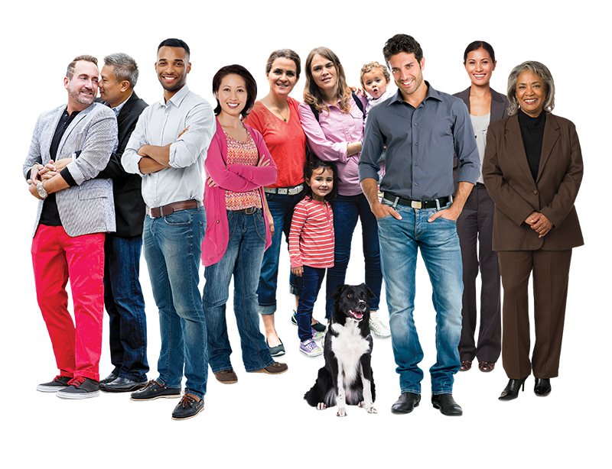

Learn more… www.CMI.info
david@CMI.info
David Paisley, Senior Research Director
Community Marketing & Insights
584 Castro St. #834
San Francisco, CA 94114
Tel +1 415/437-3800 • Fax +1 415/552-5104
Proud members since 1993

